Slide 1


Slide 2

SPE-214062-MS An Experimental Study on The Effect of Gas on The Performance of A Multi-parallel Pipe Oil-water Separator (MPPS)
Hamidreza Asaadian & Milan Stanko
Norwegian University of Science and Technology (NTNU)

Slide 3
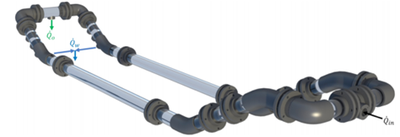
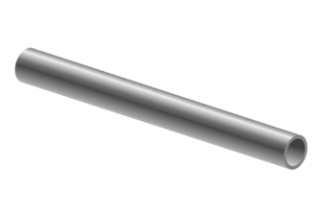


Introduction
Why Subsea Separation?
Flow assurance
More physical room
Debottlenecking of production string
Deep subsea Solution:
Pipe Separators
+ ${Q̇}_{g}$
$${Q̇}_{in}$$
MPPS prototype (Skjefstad & Stanko, 2019)
SPE-214062-MS • An Experimental Study on The of Gas on The Performance of A Multi-parallel Pipe Oil-water Separator (MPPS) • Hamidreza Asaadian

Slide 4






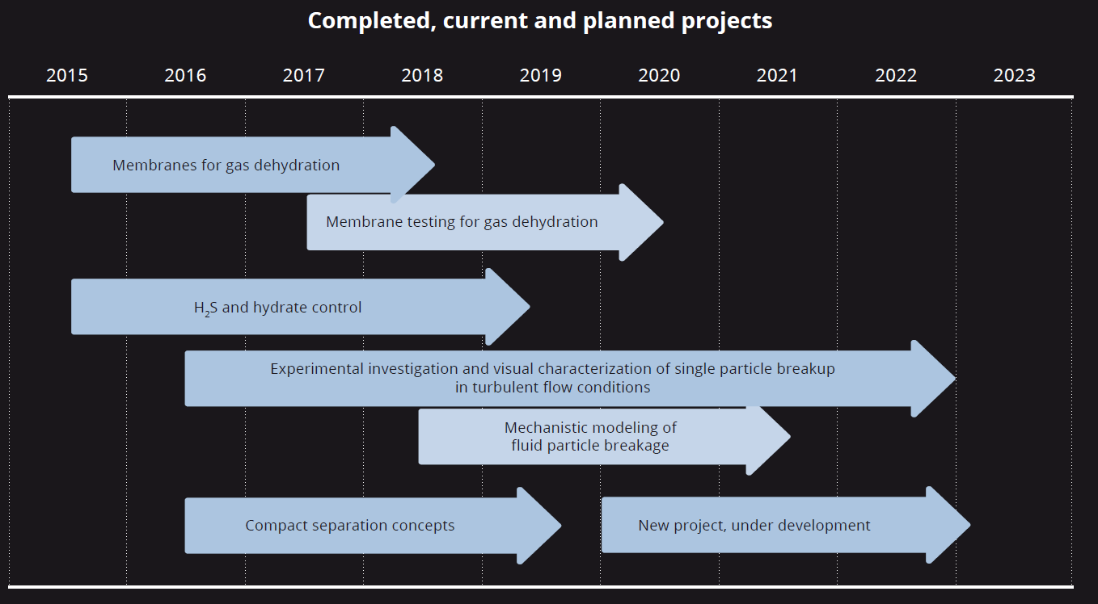
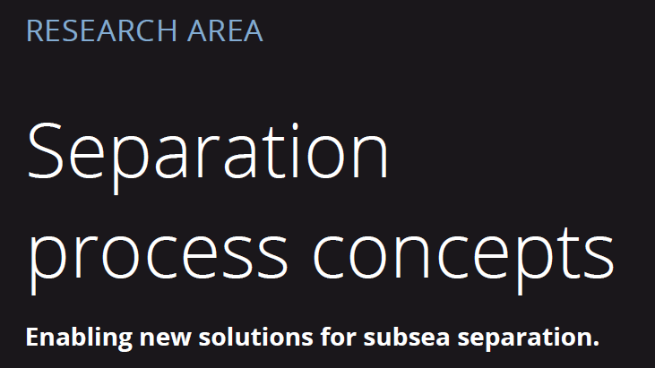
Introduction
Completed and Current Projects
PhD
Oil-water bulk separation for oil & gas applications
SPE-214062-MS • An Experimental Study on The of Gas on The Performance of A Multi-parallel Pipe Oil-water Separator (MPPS) • Hamidreza Asaadian

Slide 5
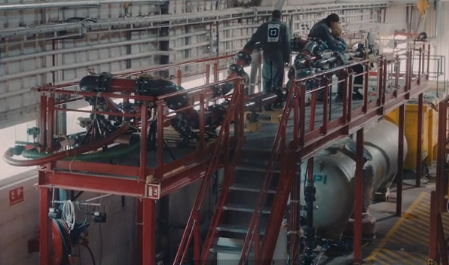
Test Rig
SPE-214062-MS • An Experimental Study on The of Gas on The Performance of A Multi-parallel Pipe Oil-water Separator (MPPS) • Hamidreza Asaadian

Slide 6
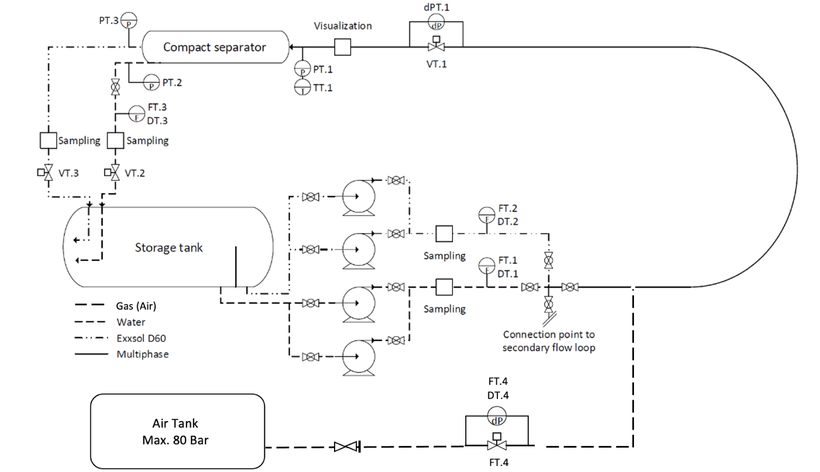
Experiment Design
Experimental setup PI&D map
Total liquid flowrate [L/min] | Water cut [%] | Gas flowrate [L/min]
300 | 30 / 50 / 70 / 90 | 0 / 2 / 5 / 10 / 20 / 30
500 | 30 / 50 / 70 / 90 | 0 / 3.4 / 8.4 / 16.7 / 33.4 / 50
700 | 30 / 50 / 70 / 90 | 0 / 4.7 / 11.7 / 23.4 / 46.7 / 70
Saltwater (3.4 %wt)
Exxsol D60 + 400 ppm Crude Spiking
Air (gas)
Experimental setup P&ID map
SPE-214062-MS • An Experimental Study on The of Gas on The Performance of A Multi-parallel Pipe Oil-water Separator (MPPS) • Hamidreza Asaadian

Slide 7
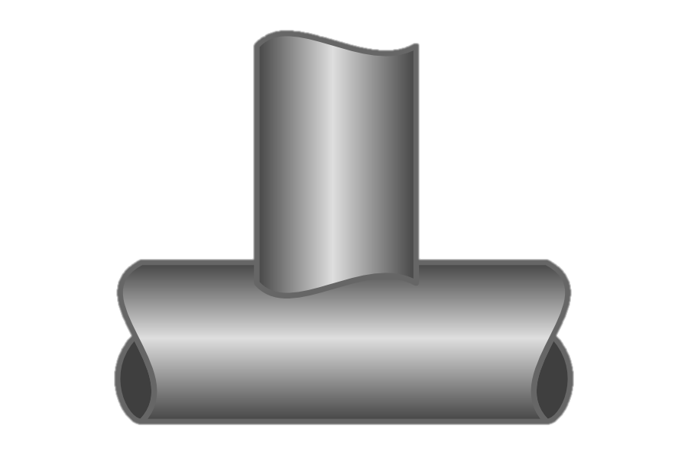




Methods
Separation Efficiency
$ε= \frac{{WC}_{3}{\text{Q}\text{̇}}_{3}}{ER({WC}_{in}\left({\text{Q}\text{̇}}_{1}+{\text{Q}\text{̇}}_{2}\right))}$
Water Cut Ratio
${WC}_{ratio}=\frac{{\text{WC}}_{3}}{{\text{WC}}_{1}}×100$
Drainage Potential Curve
$$WT \left[\%\right]= \frac{{\dot{Q}}_{water tapped}}{{\dot{Q}}_{water}} ×100$$
$\dot{Q}$_{total}
WC_{inlet}
$\dot{Q}$_{water tapped}
WC_{tapped}
SPE-214062-MS • An Experimental Study on The of Gas on The Performance of A Multi-parallel Pipe Oil-water Separator (MPPS) • Hamidreza Asaadian

Slide 8
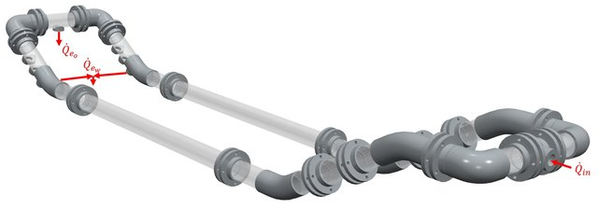
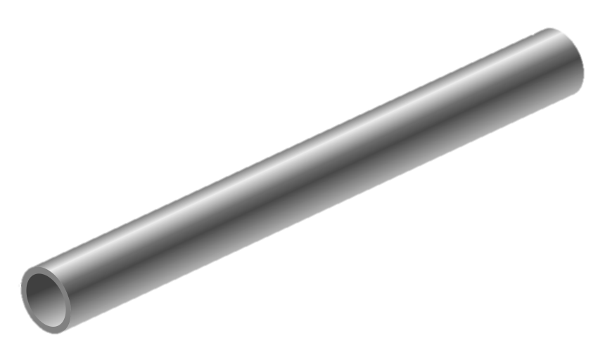
Multiphase Flow Phenomena with Presence of Gas Phase
Q_{t}
SPE-214062-MS • An Experimental Study on The of Gas on The Performance of A Multi-parallel Pipe Oil-water Separator (MPPS) • Hamidreza Asaadian

Slide 9
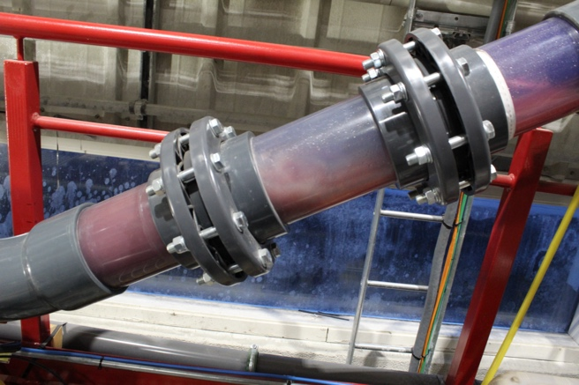
Multiphase Flow Phenomena with Presence of Gas Phase
Gas Pocket
1
Q_{t}
SPE-214062-MS • An Experimental Study on The of Gas on The Performance of A Multi-parallel Pipe Oil-water Separator (MPPS) • Hamidreza Asaadian

Slide 10
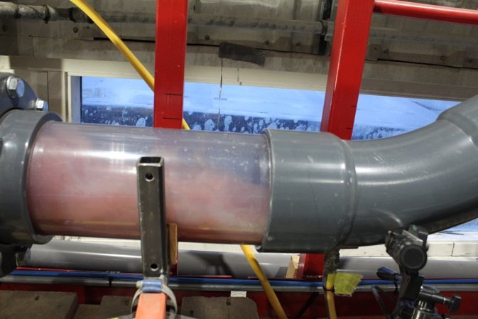
Multiphase Flow Phenomena with Presence of Gas Phase
Gas Pocket
Gas Pocket
Gas Pocket
1
Q_{t}
2
SPE-214062-MS • An Experimental Study on The of Gas on The Performance of A Multi-parallel Pipe Oil-water Separator (MPPS) • Hamidreza Asaadian

Slide 11
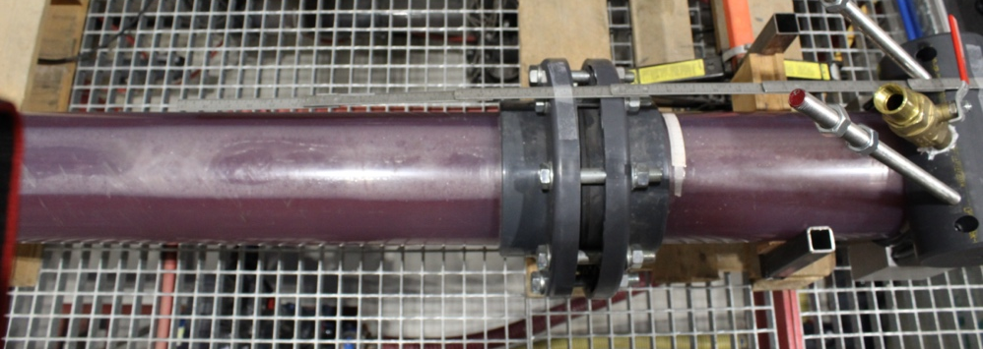
Multiphase Flow Phenomena with Presence of Gas Phase
Gas Layer
Gas Pocket
Gas Pocket
Gas Pocket
3
1
Q_{t}
2
SPE-214062-MS • An Experimental Study on The of Gas on The Performance of A Multi-parallel Pipe Oil-water Separator (MPPS) • Hamidreza Asaadian

Slide 12
Multiphase Flow Phenomena with Presence of Gas Phase
Gas Layer
Gas Pocket
Gas Pocket
High turbulency at tapping point
Gas Pocket
4
3
1
Q_{t}
2
SPE-214062-MS • An Experimental Study on The of Gas on The Performance of A Multi-parallel Pipe Oil-water Separator (MPPS) • Hamidreza Asaadian

Slide 13
Multiphase Flow Phenomena with Presence of Gas Phase
Cyclic gas release at oil outlet
Gas Layer
Gas Pocket
Gas Pocket
5
High turbulency at tapping point
Gas Pocket
4
3
1
Q_{t}
2
SPE-214062-MS • An Experimental Study on The of Gas on The Performance of A Multi-parallel Pipe Oil-water Separator (MPPS) • Hamidreza Asaadian

Slide 14
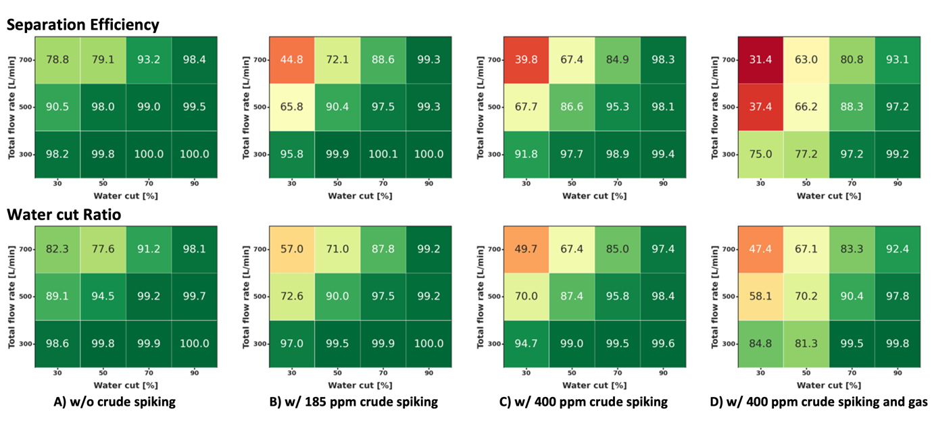
Separation Efficiencies and Water Cut Ratios
SPE-214062-MS • An Experimental Study on The of Gas on The Performance of A Multi-parallel Pipe Oil-water Separator (MPPS) • Hamidreza Asaadian

Slide 15
Separation Efficiencies
Total liquid flow rate 300 [L/min]
Total liquid flow rate 500 [L/min]
Total liquid flow rate 700 [L/min]
SPE-214062-MS • An Experimental Study on The of Gas on The Performance of A Multi-parallel Pipe Oil-water Separator (MPPS) • Hamidreza Asaadian

Slide 16
Drainage Potential Curves (Total liquid flow rate 300 [L/min])
Water cut 30%
Water cut 50%
SPE-214062-MS • An Experimental Study on The of Gas on The Performance of A Multi-parallel Pipe Oil-water Separator (MPPS) • Hamidreza Asaadian

Slide 17
Drainage Potential Curves (Total liquid flow rate 300 [L/min])
Drainage Potential Curves (Total liquid flow rate 300 [L/min])
Water cut 70%
Water cut 90%
SPE-214062-MS • An Experimental Study on The of Gas on The Performance of A Multi-parallel Pipe Oil-water Separator (MPPS) • Hamidreza Asaadian

Slide 18
Drainage Potential Curves (Total liquid flow rate 700 [L/min])
Water cut 30%
Water cut 50%
SPE-214062-MS • An Experimental Study on The of Gas on The Performance of A Multi-parallel Pipe Oil-water Separator (MPPS) • Hamidreza Asaadian

Slide 19
Drainage Potential Curves (Total liquid flow rate 700 [L/min])
Water cut 70%
SPE-214062-MS • An Experimental Study on The of Gas on The Performance of A Multi-parallel Pipe Oil-water Separator (MPPS) • Hamidreza Asaadian

Slide 20
Drainage Potential Curves (Water Cut 30 [%])
Water cut 30%
300
SPE-214062-MS • An Experimental Study on The of Gas on The Performance of A Multi-parallel Pipe Oil-water Separator (MPPS) • Hamidreza Asaadian

Slide 21
Drainage Potential Curves (Water Cut 50 [%])
Water cut 50%
300
SPE-214062-MS • An Experimental Study on The of Gas on The Performance of A Multi-parallel Pipe Oil-water Separator (MPPS) • Hamidreza Asaadian

Slide 22
Drainage Potential Curves (Water Cut 70 and 90 [%])
Water cut 70%
Water cut 90%
300
SPE-214062-MS • An Experimental Study on The of Gas on The Performance of A Multi-parallel Pipe Oil-water Separator (MPPS) • Hamidreza Asaadian

Slide 23
Conclusions
The presence of gas causes the occurrence of several phenomena inside the MPPS.
The maximum reduction in separation efficiency was recorded at a total liquid flow rate of 700 L/min.
According to experimental drainage potential curves, high inlet water cuts and low flow rates are associated with better separation efficiency.
SPE-214062-MS • An Experimental Study on The of Gas on The Performance of A Multi-parallel Pipe Oil-water Separator (MPPS) • Hamidreza Asaadian

Slide 24
Acknowledgements / Thank You / Questions
Research Council of Norway
Key industry partners involved in SUBPRO
Noralf Vedvik

